Slide 1

Leadership Skills
Notes:
When thinking about leaders in the workplace most of us think about the boss, manager, or supervisor. However, a leader does not have to be in charge or the one in a management role. A leader is someone who guides others to the realization of a goal which is a skill employers desire and appreciate in an employee.

Slide 2
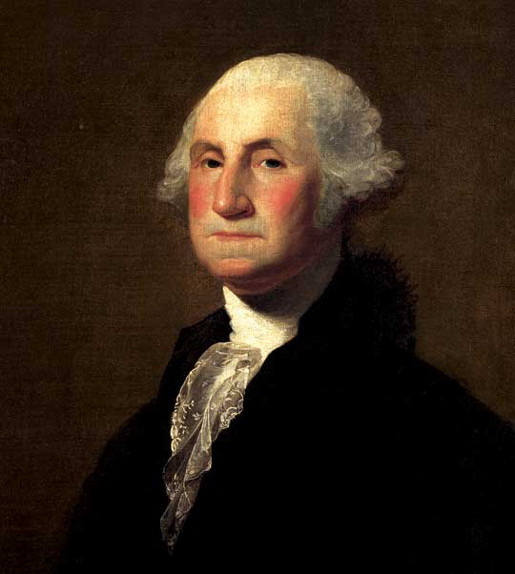
Notes:
Most people consider George Washington a great leader and the father of our country. Think about George and ask yourself what qualities he had that made him so special and defined him as a great leader. What were those qualities?
Facilitator: During this group discussion you may want to write down participant responses on a flip chart or dry erase board. These can be referred back to at the conclusion of the module.

Slide 3
What Makes a Leader ?
Honesty
Communication
Motivation
Creativity
Positivity
Responsibility
Commitment
Sense of Humor
Confidence
Flexibility
Notes:
Whatever ethical level you hold yourself to, when you are a leader you raise the bar even higher. It is important for you to demonstrate your integrity. Team members will only trust leaders they respect. By being open and honest you will encourage the same sort of honestly in your co-workers.
A leader needs to be able to clearly and succinctly explain to others everything from organizational goals to specific tasks. Leaders must master all forms of communication, including verbal and written, to be effective.
Leaders inspire others to go the extra mile for their organization. Inspiring your team to see the vision of the successes to come is vital. Make your team feel invested in the accomplishments of the company. Acknowledge the work that everyone has done. Leaders help to keep spirits up and that begins with an appreciation for everyone’s hard work.
Some decisions will not always be clear cut. You may be forced at times to deviate from your set course and make an on-the-fly decision. This is where your creativity will prove to be vital. During these situations, the team will look to a leader for guidance. Learning to try non traditional solutions or approaching problems in a nontraditional way will help you to solve an otherwise unsolvable problem. Others will be impressed and inspired by someone who doesn’t always choose the safe conventional path.
A positive attitude can go a long way in the workplace. You should be able to laugh at yourself when something doesn’t go as planned. Simple acts of kindness towards others will help to develop a positive atmosphere and raise morale among co-workers. Leaders help keep the workplace somewhere that others will want to be and are more willing to put in the effort to make the business successful.
A leader is responsible for both the success and failures of their team. You need to be willing to accept blame when something does not go correctly. If your co-workers see you pointing fingers and blaming others they will lose respect for you. Accept mistakes and then help devise clear solutions for improvement.
It is important for leaders to follow through with what they agree to do. You should be willing to put in the extra hours to complete an assignment. Leading by example is a great motivator. Seeing you down in the trenches working alongside everyone else and showing that hard work is being done by everyone at all levels in the organization is important.
If your website crashes, you lose that major client, or your funding dries up, helping to guide others through the process without panicking is as challenging as it is important. That’s where keeping a sense of humor can pay off. Learning to find the humor in the struggles can make your work environment a happy and healthy space where you and your co-workers can be productive.
Your team or co-workers will take their cue on how to act or proceed from the person who is a leader. Keep up your confidence level and help to put out fires and maintain morale. It is important to remain focused on the larger goal.
Changes are always happening at work. A good leader needs to be flexible and accept whatever changes come their way. Employees will appreciate a leader’s ability to accept changes, take them in stride and creatively problem solve. If workers are dissatisfied with an aspect of the company, you can listen to their concern and be open to making suggestions or changes. Employees will appreciate a leader’s ability to accept appropriate feedback.

Slide 4
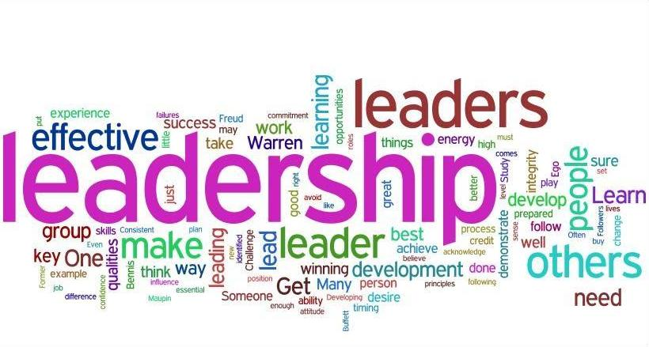
Notes:
A leader is anyone within a business who guides others towards the realization of a work goal. What are your leadership skills? How well do you lead?
Facilitator: Handout the Leadership Skills Self Assessment. Allow participants time to complete the assessment.

Slide 5
Leadership Styles
Authoritarian
Paternalistic
Democratic
Laissez-faire
Transactional
Transformational
Notes:
Once you have assessed your management skills, you can build on your strengths and improve the areas that are weaker so you can become a more effective leader. There are 6 basic leadership styles that use the skills we have identified.
Authoritarian leadership keeps strict, close control over a team and regulates policies and procedures. The leader using this style is in a position of having to get something done or get a point across.
Paternalistic leadership works by acting as a father figure by taking care of others as a parent would. This style is usually very organized and allows the worker to complete tasks so that they can stay on top of the work.
The Democratic style consists of the leader sharing the decision making abilities with the team. It encompasses discussion, debate and sharing of ideas. This style is very productive but does not work well when time is of the essence.
The laissez-faire leadership style is where all the rights and power to make decisions is fully given to the employees. Workers are given the job assignment and left on their own to be successful. Leaders provide assistance or feedback only when the team requests it.
Transactional leaders focus their leadership on motivating followers through a system of rewards and punishments. It is more concerned with following existing rules than with making changes to the organization.
With Transformational leadership the objective is to work to change or transform. This style inspires the team with a sense of purpose and excitement. It is charismatic.

Slide 6

Notes:
No one style of leadership works for all people and in all situations. A good leader will “mix and match” all their skills and a variety of styles to accomplish their goals. Whether you are an office manager, project leader, or the member of a work team, all good leaders require a number of soft skills to help them positively interact with others. Employers seek these skills in the candidates they hire.

Slide 7
References
Leadership Skills Inventory by Legacy by Design, LLC
Top 10 Leadership Soft Skills by Alison Doyle retrieved from http://jobsearch.about.com/od/skills/qt/leadership-skills
Lead with Integrity! Leadership & Ethics by Ann Cross and Martha Lanaghen, JIST Publishing
Top 10 Qualities that Make a Great Leader retrieved from www.forbes.com/sites/tanyaprive/2012/12/19/top-ten-qualities-that-make-a-great-leader
Leadership Style from Wikipedia retrieved from http://en.wikipedia.org/wiki/Leadership_style

